Slide 1
Scope of work
Project Proposal

Slide 2
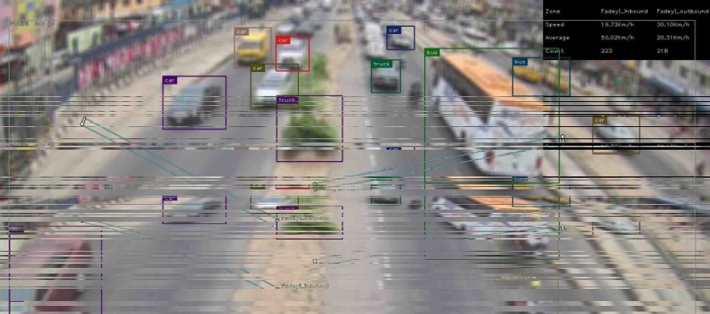
Country Route Hazard Map Project
Our aim is to deliver a sustainable route hazard database that captures all the required information which will promote safety of the business unit and sustain a reliable RoI. As a seasoned data manager, with our organic and AI tools we shall deliver details reporting in accordance with the template provided
We have delivered data-bases for Out of home industry, FMCG and Banking industries, which help them to manage their business expansion decision and risk appetite effectively
With the use of our highly intelligent AI devices to capture typical traffic volume and probe devices that detect the vehicle heart beat, vehicle types and the use of google data encryption, we will provide all required data with 99.99% accuracy. We shall deploy one on one
in-person survey eye witness for a detail locality information
All data will be captured with proper guideline according to
Nigeria data Protection laws

Slide 3
Content Deliveries
Specific route traffic behaviour
Detail traffic volume summation (tro and fro route traffic data per vehicle type, motorcycle volume, pedestrian`s demographic details)
Identification of route bottleneck
Identification of nearest Police station
Identification of nearest health centre
Identification of narrow bridge
Recommendation on road closure notice or road construction
Provision of detail alternative routes
Identification of nearest NEMA/FRSC station
Weather status
Identification of black spot
Details reporting of typical armed robbery incident
Identification of hazards per km (land grabbers, touts, security treat)
Typical route event forecast (native festivals and weather condition)
Identification of rest point for drivers with packing point safety
Mapping of rest point, black spot, rest point with recommendation
Identification of alternative route with their seasonal traffic behaviour

Slide 4
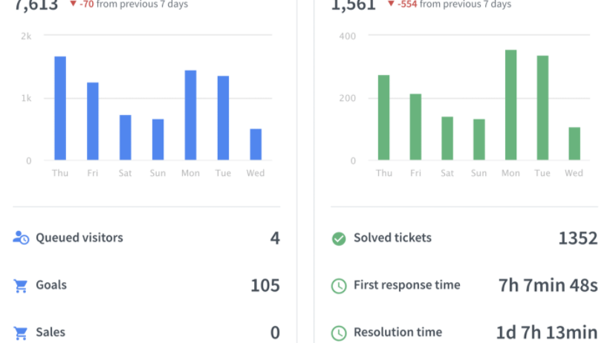
Pricing
West : 10million Naira
East : 10million Naira
North : 7million Naira

Slide 5
Recommendation
Introduction of Dash camera
Introduction of vehicle tracker
Introduction of truck tank monitoring and fuel management system
Foot-print Reporting and Analysis
We recommend the following for safety and better ROI

Slide 6
THANK YOU

